Slide 1
Warm-up as you walk in
Each node in a Bayes net represents a conditional probability distribution.
What distribution do you get when you multiply all of these conditional probabilities together?
$$P\left(A\right) P\left(B | A\right) P\left(C | A\right) P\left(D | C\right) P(E|C)$$

Slide 2
Announcements
Midterm:
Mon 4/8, in-class
See Piazza for details
Course survey:
Thanks!
A few notes
In-class polls
Lectures
Recitation
TAs
Beyond Pac-man/Gridworld

Slide 3
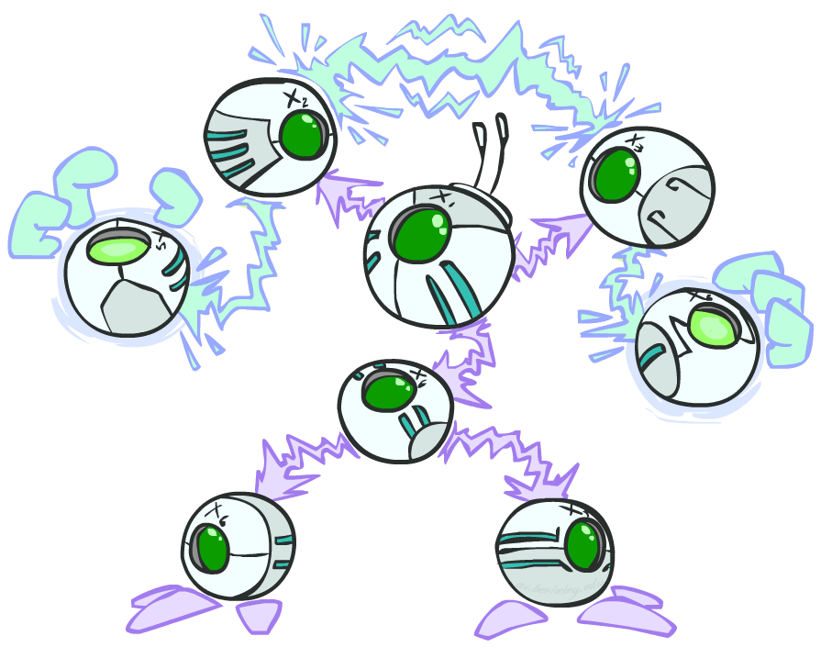
AI: Representation and Problem Solving
Bayes Nets Independence
Instructors: Pat Virtue & Stephanie Rosenthal
Slide credits: CMU AI and http://ai.berkeley.edu

Slide 4
Piazza Poll 1
Each node in a Bayes net represents a conditional probability distribution.
What distribution do you get when you multiply all of these conditional probabilities together?
Marginal
Conditional
Joint
Poisson
$$P\left(A\right) P\left(B | A\right) P\left(C | A\right) P\left(D | C\right) P(E|C)$$

Slide 5
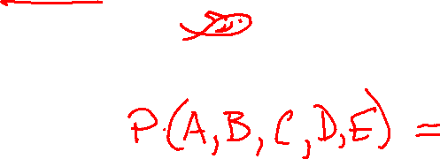
Piazza Poll 1
Each node in a Bayes net represents a conditional probability distribution.
What distribution do you get when you multiply all of these conditional probabilities together?
Marginal
Conditional
Joint
Poisson
$$P\left(A\right) P\left(B | A\right) P\left(C | A\right) P\left(D | C\right) P(E|C)$$

Slide 6
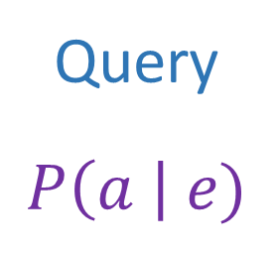
Answer Any Query from Condition Probability Tables
Bayes Net
Joint
Query
$$P\left(a \right| e)$$
$$P\left(A\right) P\left(B | A\right) P\left(C | A\right) P\left(D | C\right) P(E|C)$$

Slide 7
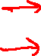
Bayes Net Independence Assumptions
Bayes Net
CPTs to Joint
Chain rule
Bayes net model
Causality (or not)
Markov assumptions
$$P\left(A\right) P\left(B | A\right) P\left(C | A\right) P\left(D | C\right) P(E|C)$$
$P\left(A\right) P\left(B | A\right) P\left(C | A,B\right) P\left(D | A,B,C\right)$ $P(E|A, B,C,D)$

Slide 8
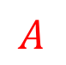

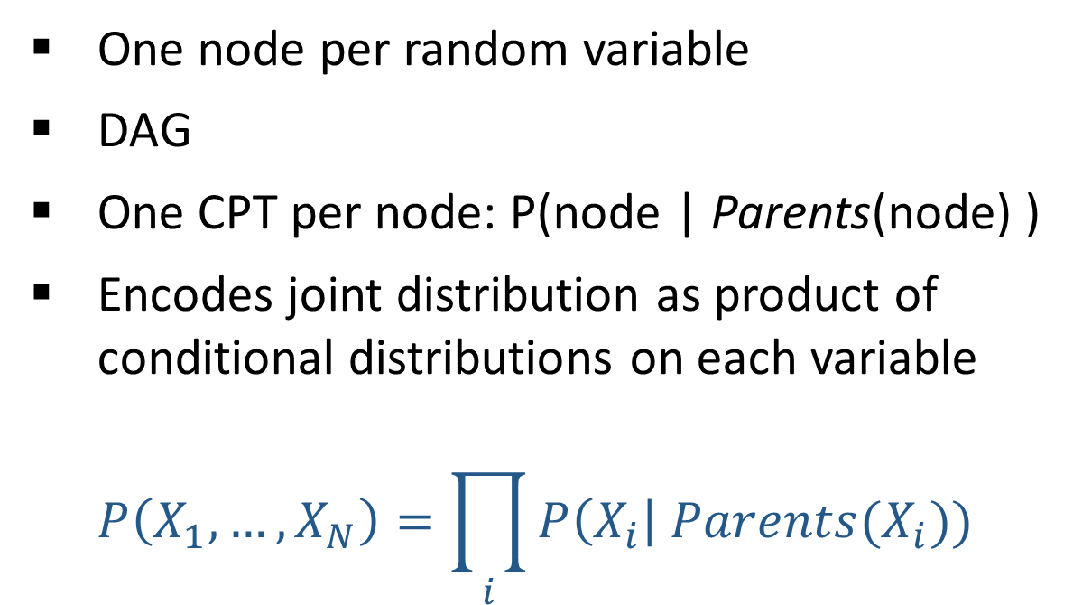

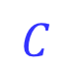

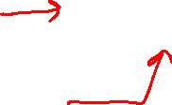
Bayes Nets Representation
One node per random variable
DAG
One CPT per node: P(node | Parents(node) )
Encodes joint distribution as product of conditional distributions on each variable
$$P\left(X_{1},…,X_{N}\right)=\prod_{i}{P\left(X_{i}\right| Parents(X_{i})) }$$
Bayes net
$$A$$
$$B$$
$$C$$
$$D$$
$$E$$

Slide 9
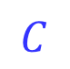
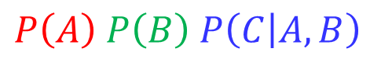
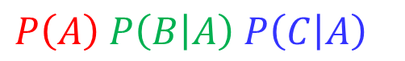
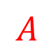

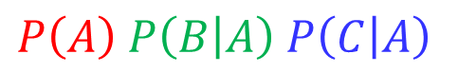
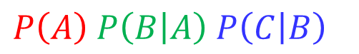
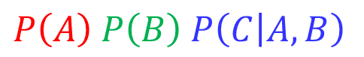
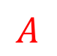
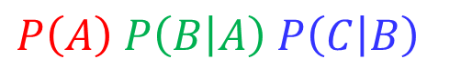
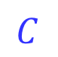
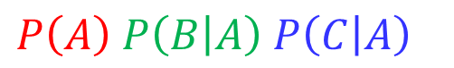

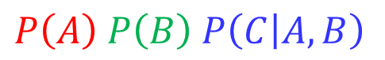

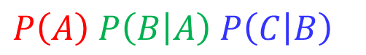
Piazza Poll 2
Match the product of CPTs to the Bayes net.
I.
II.
III.
$$A$$
$$A$$
$$B$$
$$A$$
$$B$$
$$C$$
$$B$$
$$C$$
$$C$$
$$P\left(A\right) P\left(B | A\right) P\left(C | B\right)$$
$$P\left(A\right) P\left(B | A\right) P\left(C | A\right)$$
$$P\left(A\right) P\left(B\right) P\left(C | A, B\right)$$
$$P\left(A\right) P\left(B\right) P\left(C | A, B\right)$$
$$P\left(A\right) P\left(B | A\right) P\left(C | B\right)$$
$$P\left(A\right) P\left(B | A\right) P\left(C | A\right)$$
$$P\left(A\right) P\left(B | A\right) P\left(C | A\right)$$
$$P\left(A\right) P\left(B\right) P\left(C | A, B\right)$$
$$P\left(A\right) P\left(B | A\right) P\left(C | B\right)$$

Slide 10

Piazza Poll 2
Match the product of CPTs to the Bayes net.
I.
II.
III.
$$A$$
$$A$$
$$B$$
$$A$$
$$B$$
$$C$$
$$B$$
$$C$$
$$C$$
$$P\left(A\right) P\left(B | A\right) P\left(C | B\right)$$
$$P\left(A\right) P\left(B | A\right) P\left(C | A\right)$$
$$P\left(A\right) P\left(B\right) P\left(C | A, B\right)$$
$$P\left(A\right) P\left(B\right) P\left(C | A, B\right)$$
$$P\left(A\right) P\left(B | A\right) P\left(C | B\right)$$
$$P\left(A\right) P\left(B | A\right) P\left(C | A\right)$$
$$P\left(A\right) P\left(B | A\right) P\left(C | A\right)$$
$$P\left(A\right) P\left(B\right) P\left(C | A, B\right)$$
$$P\left(A\right) P\left(B | A\right) P\left(C | B\right)$$

Slide 11
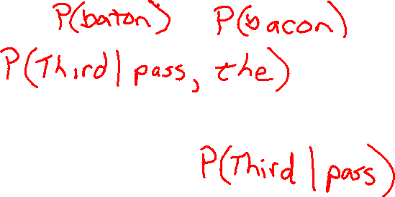
Bayes Nets in the Wild
Wheel of Fortune

Slide 12
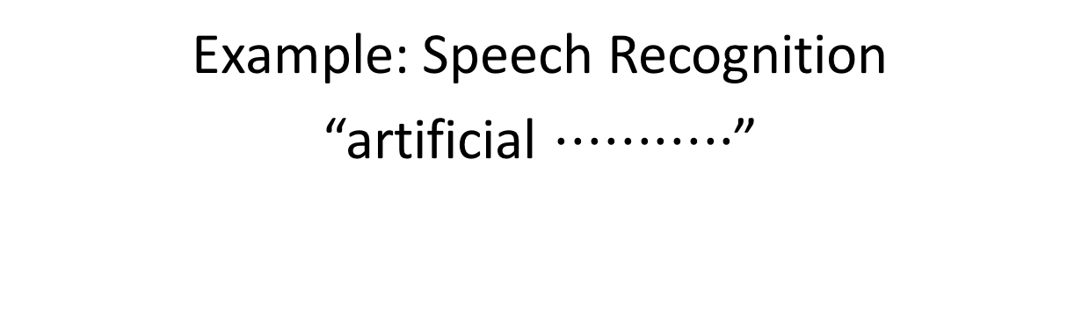
Bayes Nets in the Wild
Example: Speech Recognition
“artificial $⋅⋅⋅⋅⋅⋅⋅⋅⋅⋅⋅$”
Find most probable next word given “artificial” and the audio for second word.

Slide 13
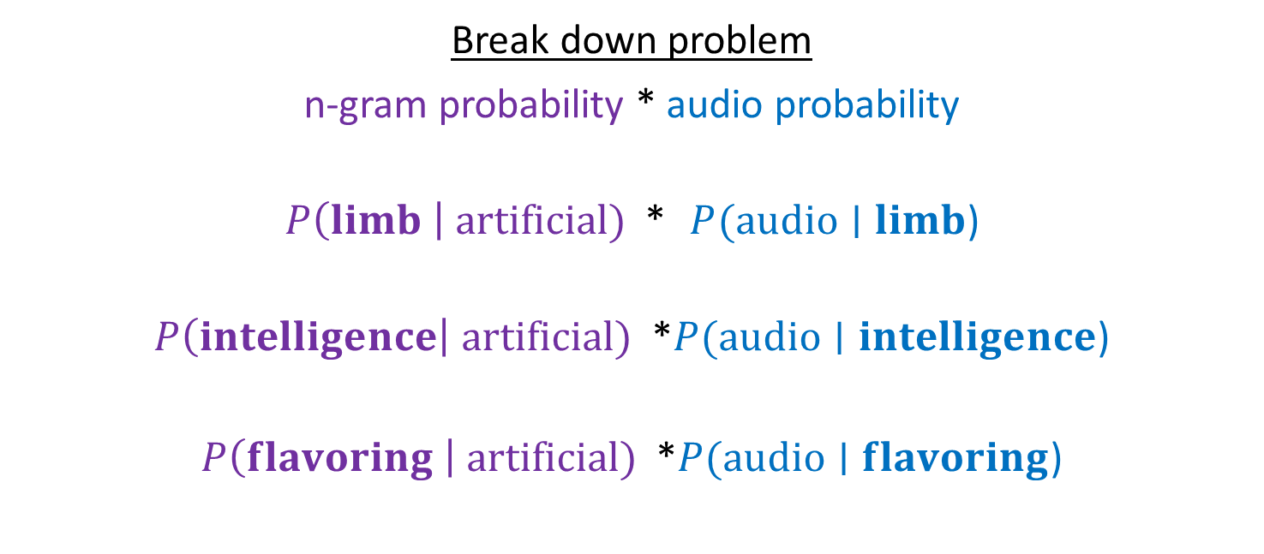
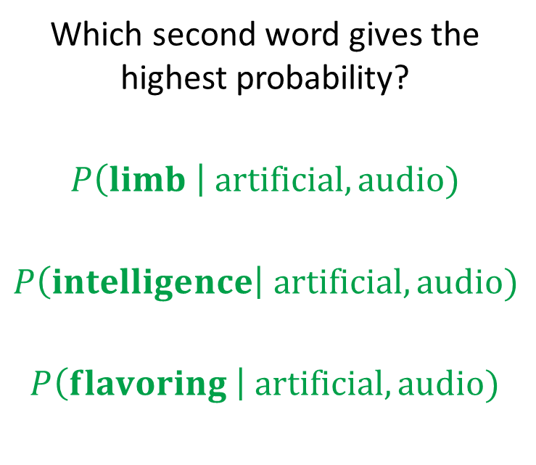
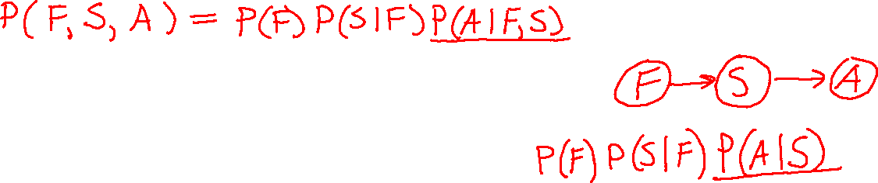
Bayes Nets in the Wild
Example: Speech Recognition
“artificial $⋅⋅⋅⋅⋅⋅⋅⋅⋅⋅⋅$”
Find most probable next word given “artificial” and the audio for second word.
Which second word gives the highest probability?
$$P\left(limb \right| artificial, audio)$$
$$P\left(intelligence\right| artificial, audio)$$
$$P\left(flavoring \right| artificial, audio)$$
Break down problem
n-gram probability * audio probability
$P\left(limb \right| artificial)$ * $P(audio∣limb$)
$P\left(intelligence\right| artificial)$ *$P(audio∣intelligence$)
$P\left(flavoring \right| artificial)$ *$P(audio∣flavoring$)

Slide 14
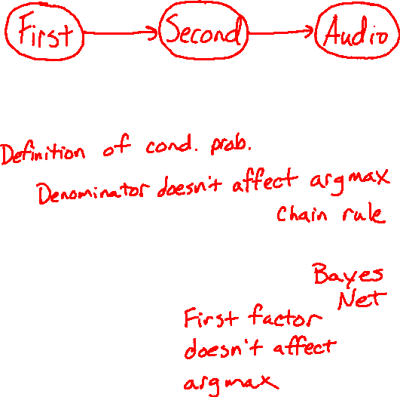
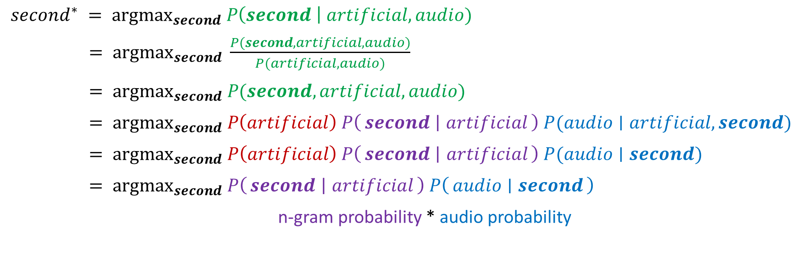
Bayes Nets in the Wild
$second^{∗} = {argmax}_{second} P\left(second \right| artificial, audio)$
$= {argmax}_{second} \frac{P(second, artificial, audio)}{P(artificial, audio)}$
$= {argmax}_{second} P(second, artificial, audio)$
$= {argmax}_{second} P\left(artificial\right) P\left(second ∣ artificial\right) P(audio∣artificial, second)$
$= {argmax}_{second} P\left(artificial\right) P\left(second ∣ artificial\right) P(audio∣second)$
$= {argmax}_{second} P\left(second ∣ artificial\right) P\left(audio ∣ second\right)$
n-gram probability * audio probability

Slide 15
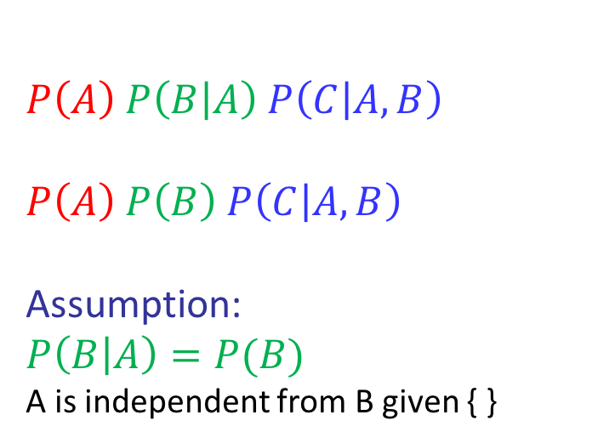
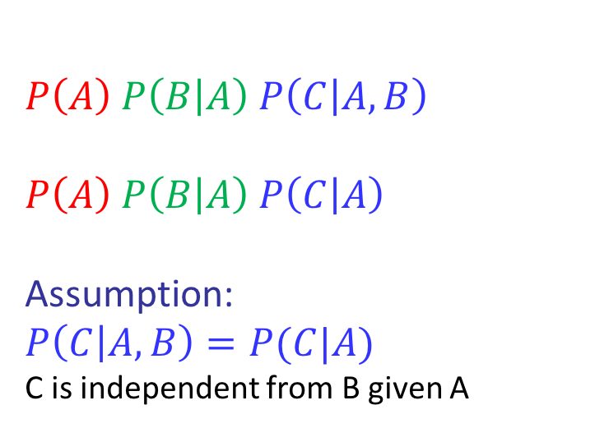
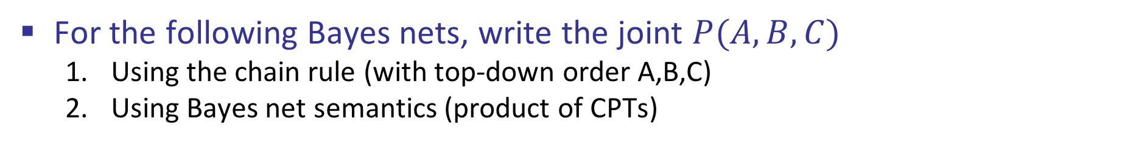
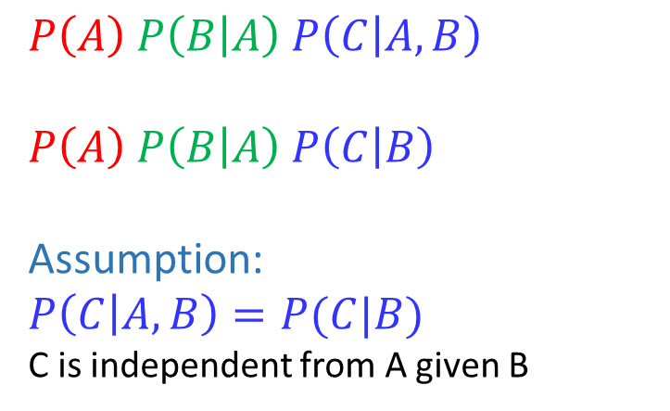
Conditional Independence Semantics
For the following Bayes nets, write the joint $P(A,B,C)$
Using the chain rule (with top-down order A,B,C)
Using Bayes net semantics (product of CPTs)
$$A$$
$$A$$
$$B$$
$$A$$
$$B$$
$$C$$
$$B$$
$$C$$
$$C$$
$$P\left(A\right) P\left(B | A\right) P\left(C | A,B\right)$$
$$P\left(A\right) P\left(B | A\right) P\left(C | B\right)$$
Assumption:
$$P\left(C | A,B\right)=P(C|B)$$
C is independent from A given B
$$P\left(A\right) P\left(B | A\right) P\left(C | A,B\right)$$
$$P\left(A\right) P\left(B | A\right) P\left(C | A\right)$$
Assumption:
$$P\left(C | A,B\right)=P(C|A)$$
C is independent from B given A
$$P\left(A\right) P\left(B | A\right) P\left(C | A,B\right)$$
$$P\left(A\right) P\left(B\right) P\left(C | A, B\right)$$
Assumption:
$$P\left(B | A\right)=P(B)$$
A is independent from B given { }

Slide 16
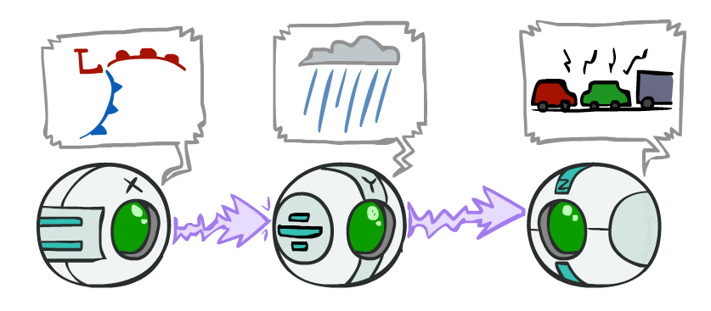
Causal Chains
This configuration is a “causal chain”
Guaranteed X independent of Z ? No!
One example set of CPTs for which X is not independent of Z is sufficient to show this independence is not guaranteed.
Example:
Low pressure causes rain causes traffic,
high pressure causes no rain causes no
traffic
In numbers:
P( +y | +x ) = 1, P( -y | - x ) = 1,
P( +z | +y ) = 1, P( -z | -y ) = 1
X: Low pressure Y: Rain Z: Traffic

Slide 17
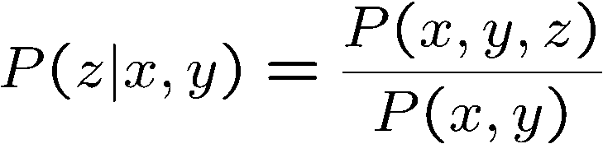
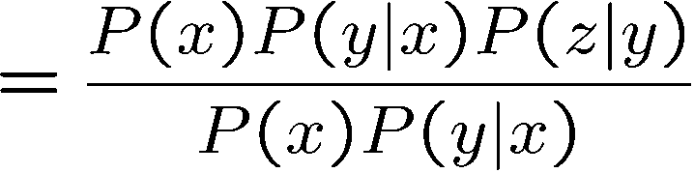
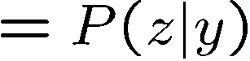
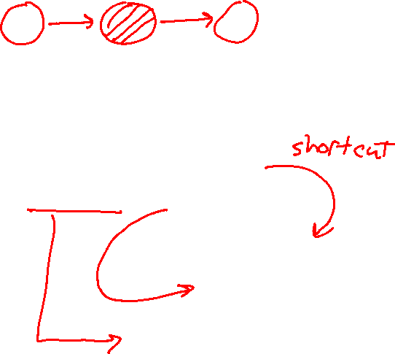
Causal Chains
This configuration is a “causal chain”
Guaranteed X independent of Z given Y?
Evidence along the chain “blocks” the influence
X: Low pressure Y: Rain Z: Traffic
Yes!

Slide 18
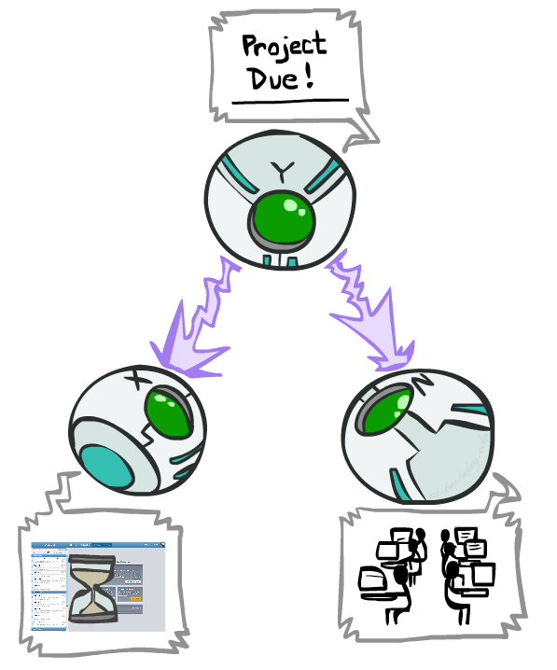
Common Cause
This configuration is a “common cause”
Guaranteed X independent of Z ? No!
One example set of CPTs for which X is not independent of Z is sufficient to show this independence is not guaranteed.
Example:
Project due causes both forums busy
and lab full
In numbers:
P( +x | +y ) = 1, P( -x | -y ) = 1,
P( +z | +y ) = 1, P( -z | -y ) = 1
Y: Project due
X: Forums busy
Z: Lab full

Slide 19
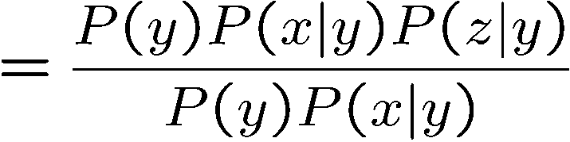
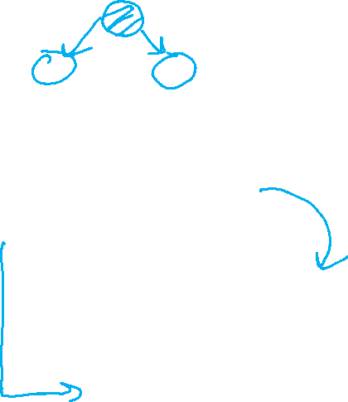
Common Cause
This configuration is a “common cause”
Guaranteed X and Z independent given Y?
Observing the cause blocks influence between effects.
Y: Project due
X: Forums busy
Z: Lab full
Yes!

Slide 20
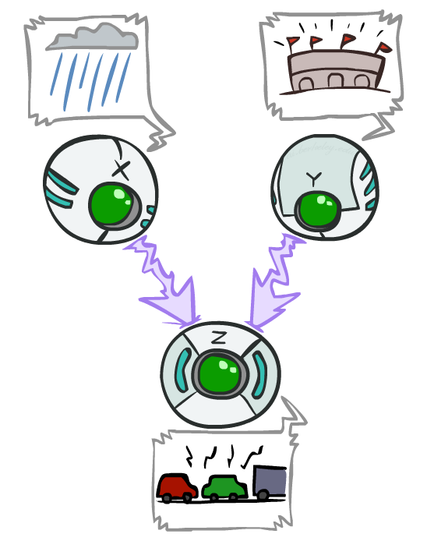
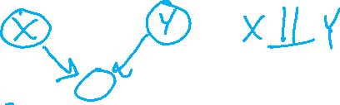
Common Effect
Last configuration: two causes of one effect (v-structures)
Are X and Y independent?
Yes: the ballgame and the rain cause traffic, but they are not correlated
Still need to prove they must be (try it!)
Are X and Y independent given Z?
No: seeing traffic puts the rain and the ballgame in competition as explanation.
This is backwards from the other cases
Observing an effect activates influence between possible causes.
X: Raining
Y: Ballgame
Z: Traffic

Slide 21
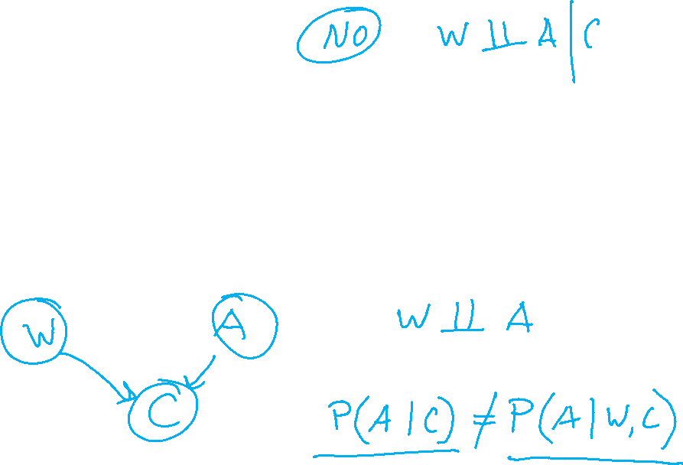
Practice
Consider the case where you show up to Claire’s office hours and she isn’t there
Draw a Bayes Net capturing the causal relationship between Claire being in the room (yes/no), Claire being abducted by aliens (yes/no), and your watch having the wrong time (yes/no)
What statements about independence can you make?

Slide 22
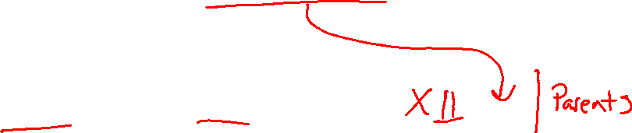
Conditional Independence Semantics
Every variable is conditionally independent of its non-descendants given its parents

Slide 23
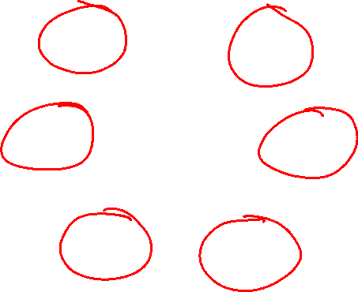
Markov blanket
A variable’s Markov blanket consists of parents, children, children’s other parents
Every variable is conditionally independent of all other variables given its Markov blanket

Slide 24
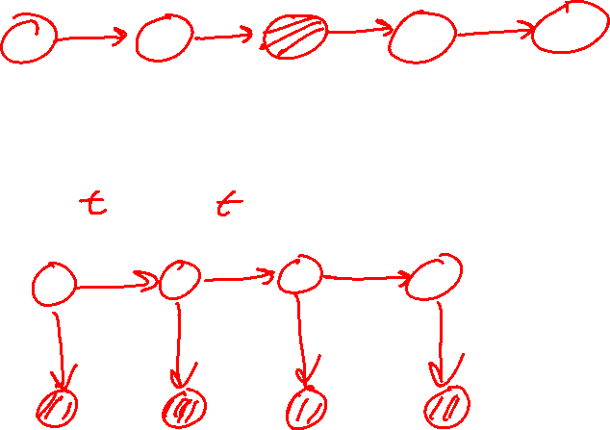
Markov Structures

Slide 25
Answer Any Query from Condition Probability Tables
Bayes Net
Joint
Query
$$P\left(a \right| e)$$
$$P\left(A\right) P\left(B | A\right) P\left(C | A\right) P\left(D | C\right) P(E|C)$$

Slide 26
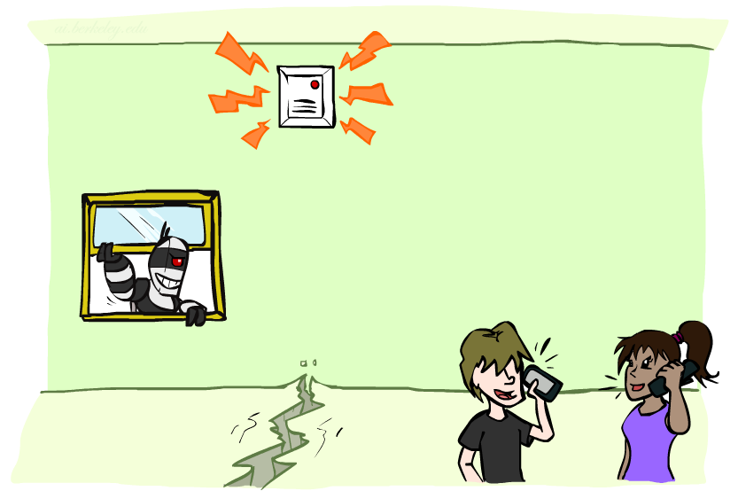
Example: Alarm Network
Variables
B: Burglary
A: Alarm goes off
M: Mary calls
J: John calls
E: Earthquake!

Slide 27
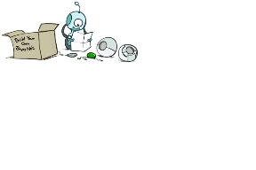
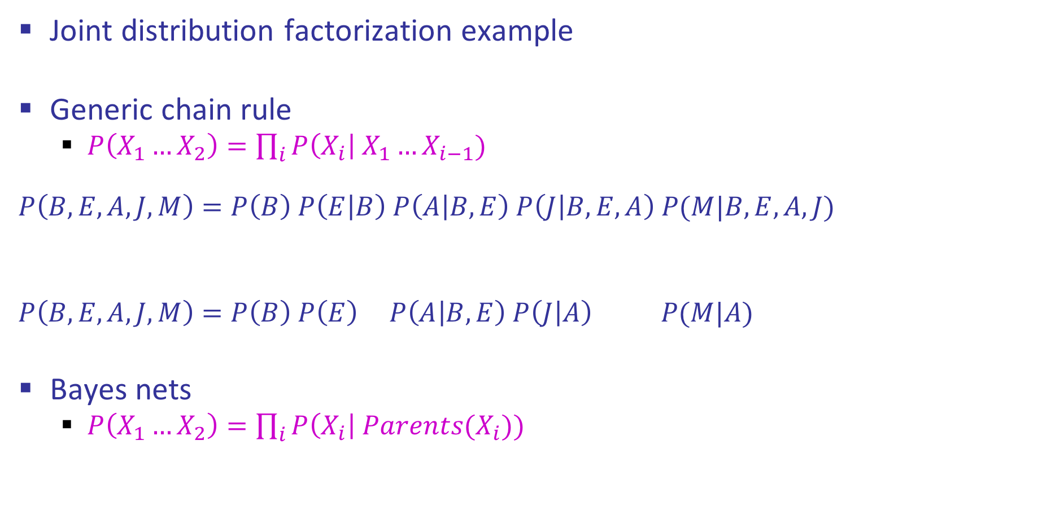
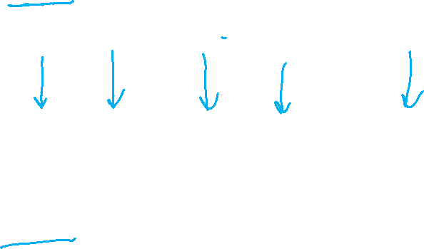
Example: Alarm Network
Joint distribution factorization example
Generic chain rule
$P\left(X_{1}…X_{2}\right)=\prod_{i}{P\left(X_{i}\right| X_{1}…X_{i−1}) }$
$$P\left(B,E,A,J,M\right)=P\left(B\right) P\left(E | B\right) P\left(A | B,E\right) P\left(J | B,E,A\right) P(M|B,E,A,J)$$
$$P\left(B,E,A,J,M\right)=P\left(B\right) P\left(E\right) P\left(A | B,E\right) P\left(J | A\right) P(M|A)$$
Bayes nets
$P\left(X_{1}…X_{2}\right)=\prod_{i}{P\left(X_{i}\right| Parents(X_{i})) }$
Burglary
Earthquake
Alarm
John calls
Mary calls

Slide 28


Example: Alarm Network
B | P(B)
+b | 0.001
-b | 0.999
E | P(E)
+e | 0.002
-e | 0.998
Burglary
Earthqk
Alarm
B | E | A | P(A|B,E)
+b | +e | +a | 0.95
+b | +e | -a | 0.05
+b | -e | +a | 0.94
+b | -e | -a | 0.06
-b | +e | +a | 0.29
-b | +e | -a | 0.71
-b | -e | +a | 0.001
-b | -e | -a | 0.999
John calls
Mary calls
A | J | P(J|A)
+a | +j | 0.9
+a | -j | 0.1
-a | +j | 0.05
-a | -j | 0.95
A | M | P(M|A)
+a | +m | 0.7
+a | -m | 0.3
-a | +m | 0.01
-a | -m | 0.99
Notes:
demo

